Slide 1

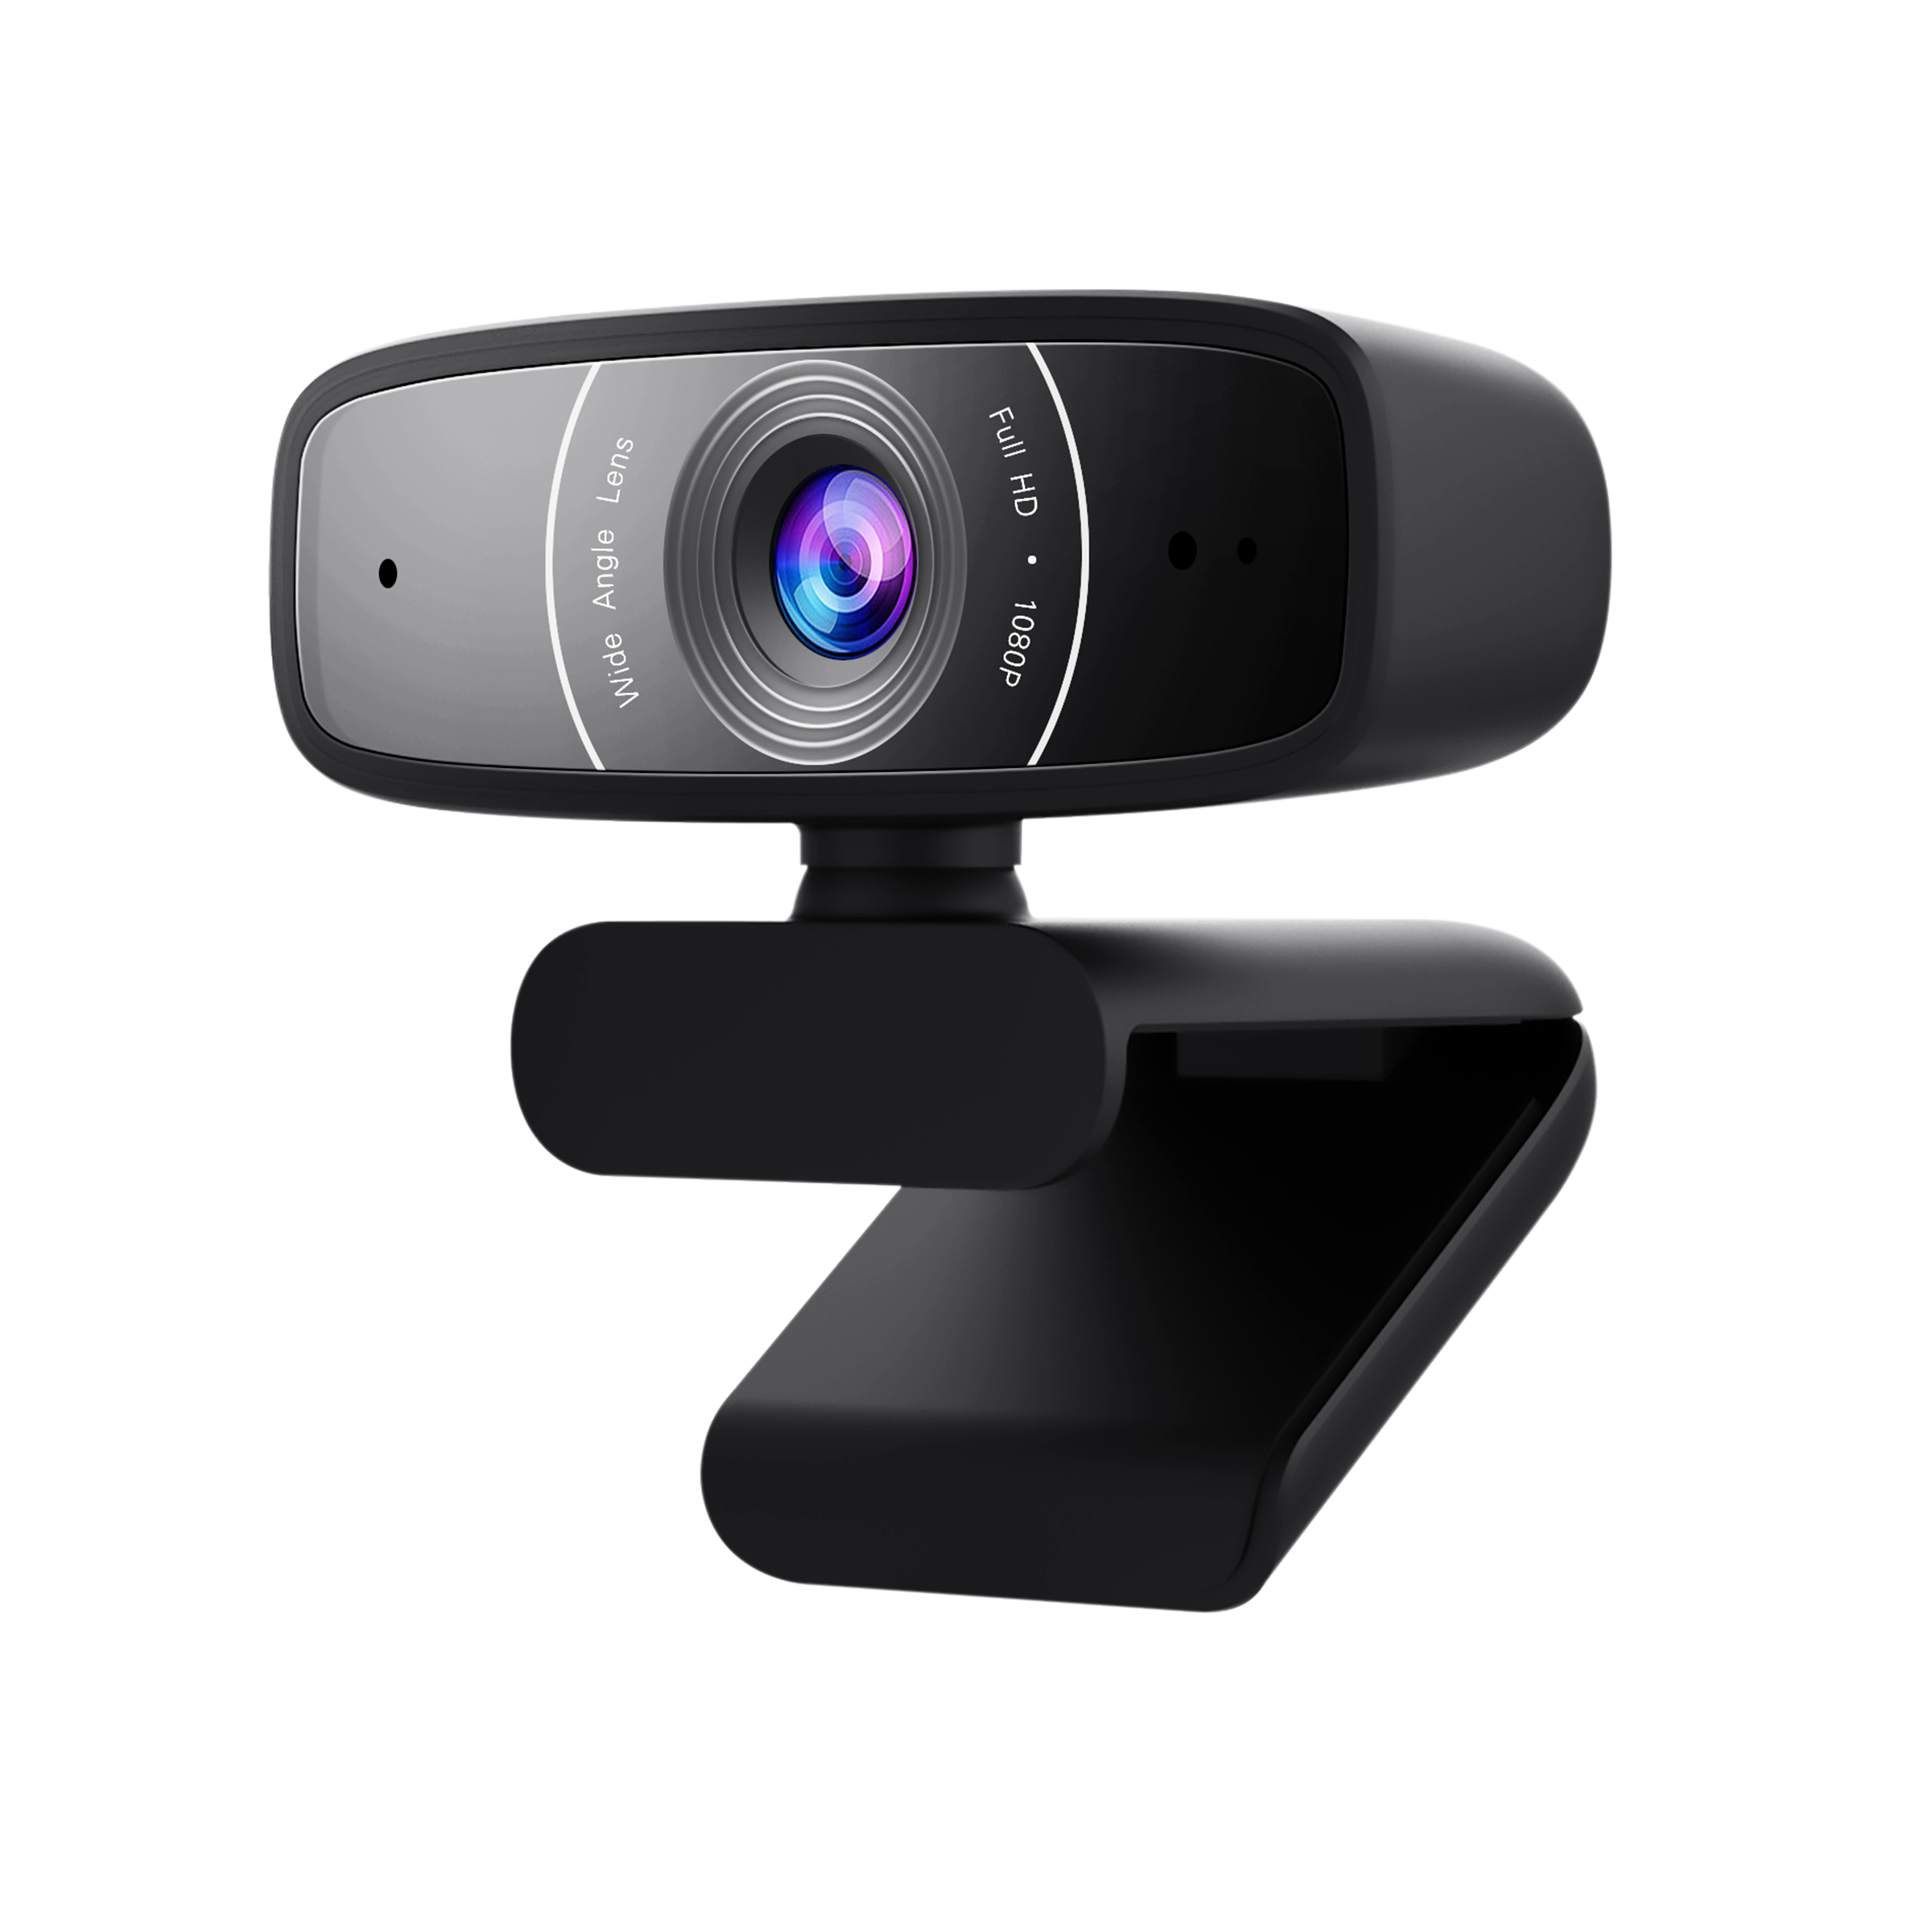

Man-in-the-Middle Attack against Object Detection
Han Wu, 2nd year Ph.D. student
Is it possible to attack an object detection system?
USB Camera
Detection System

Slide 2

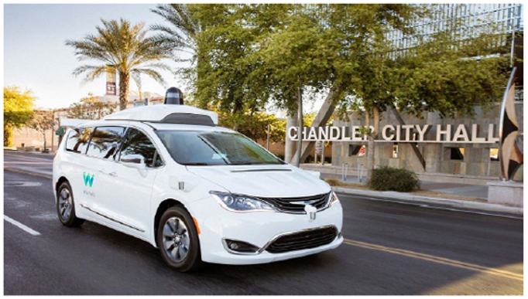
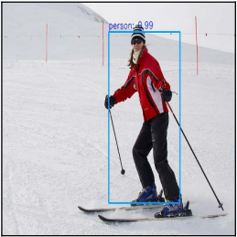

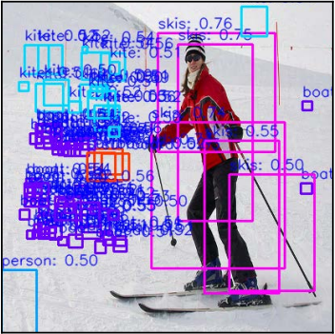


Data Centre
Waymo (formerly Google self-driving project)
Benign
Perturbation
Adversarial

Slide 3
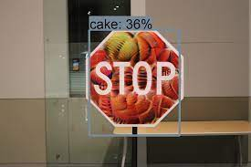

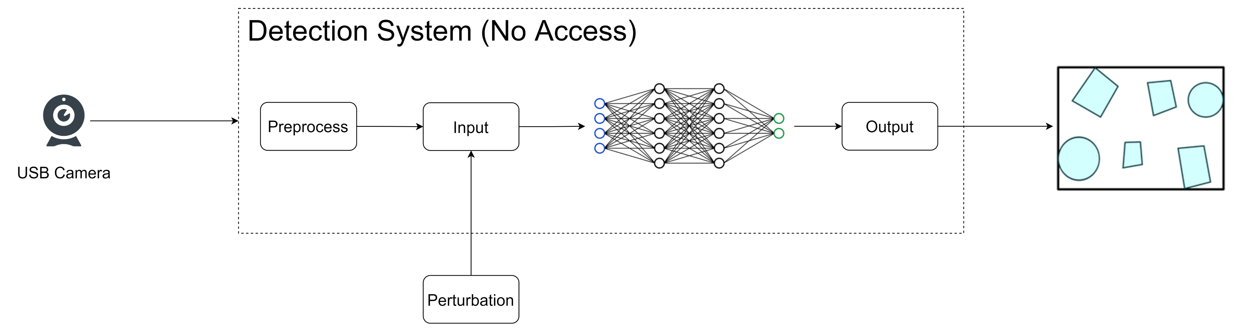
Physical Attack
Digital Attack
USB Camera
Detection System
Detection results

Slide 4
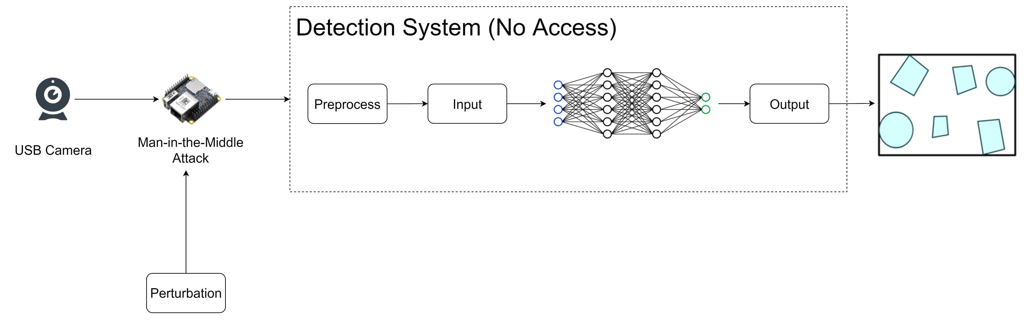
Step 1: Plug in the hardware
Hardware
Invertible Resize

Slide 5
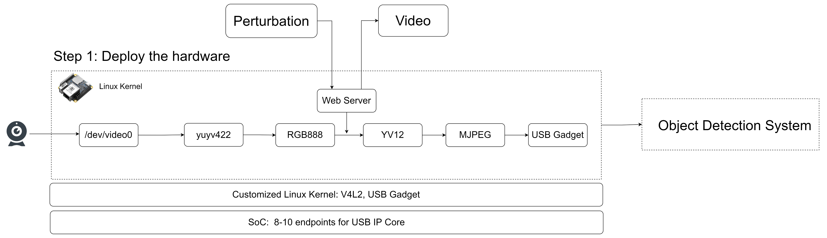
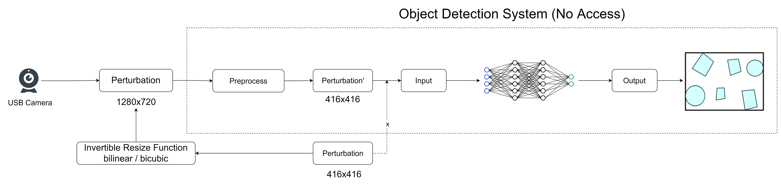
Step 2: Model Probing

Slide 6
Step 3: Adversarial Filter
Attack method
Evaluation metrics (Box Confidence Probability)
04-06 Experiments
04-05 2nd year report

Slide 7
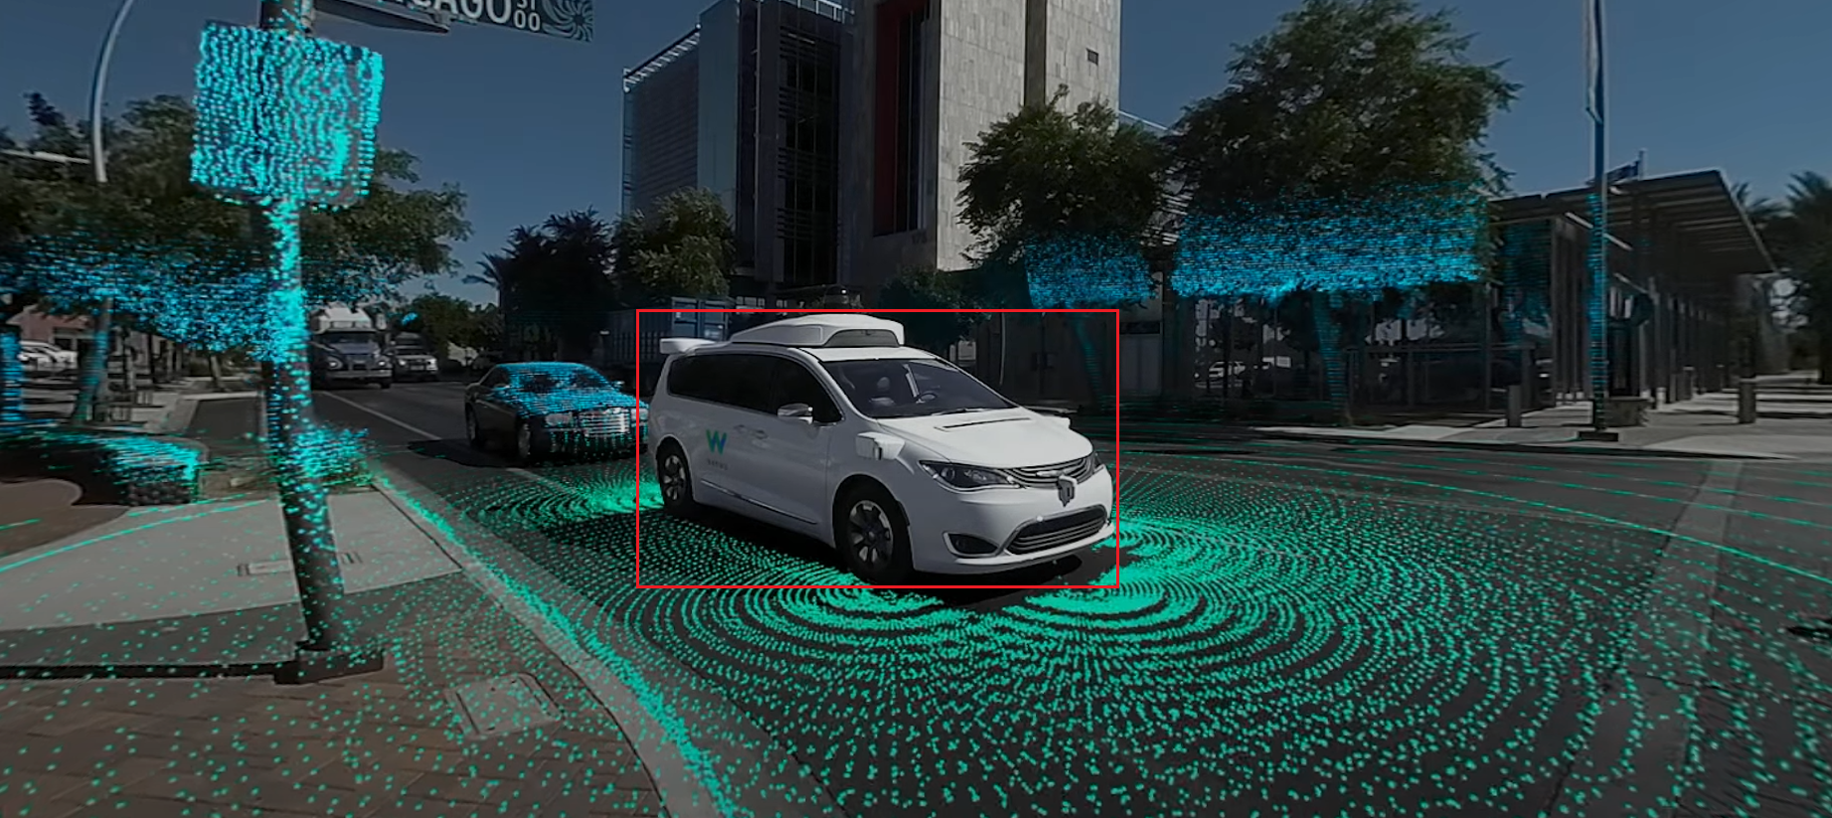

Slide 8
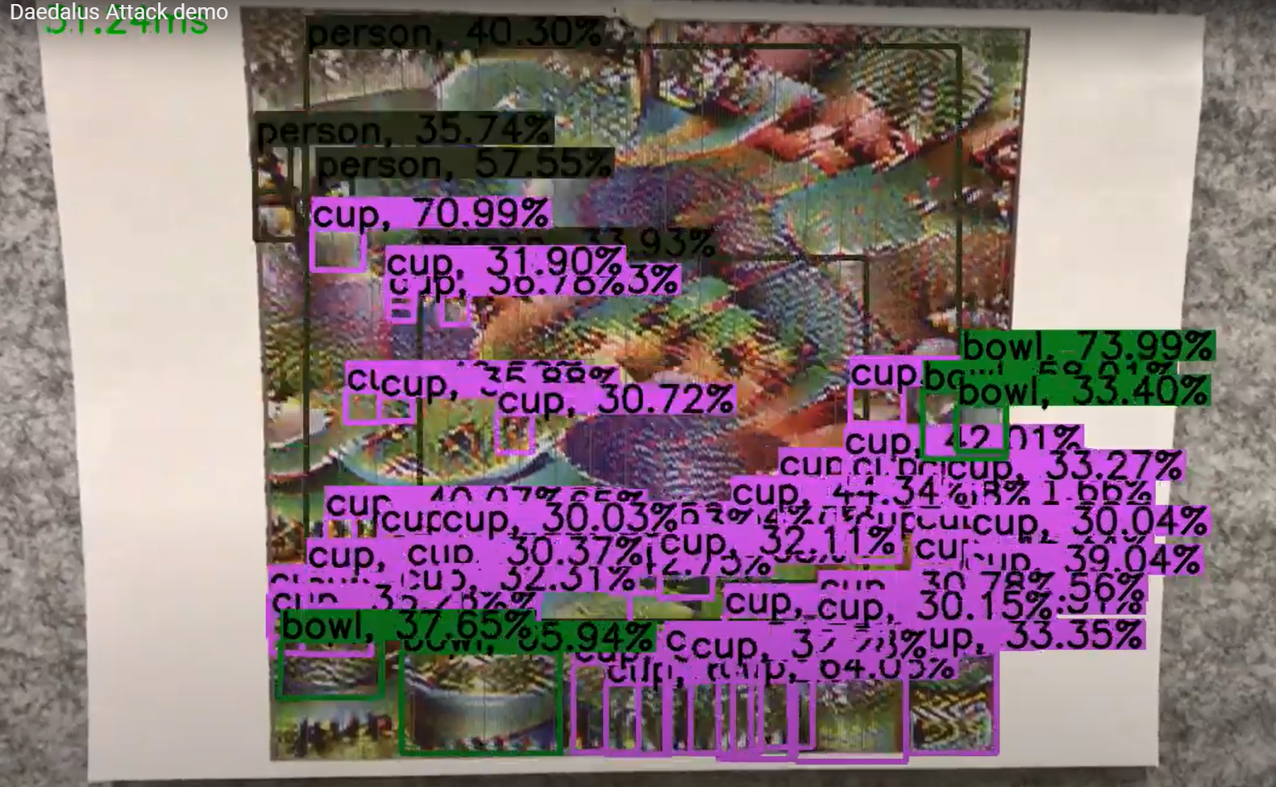
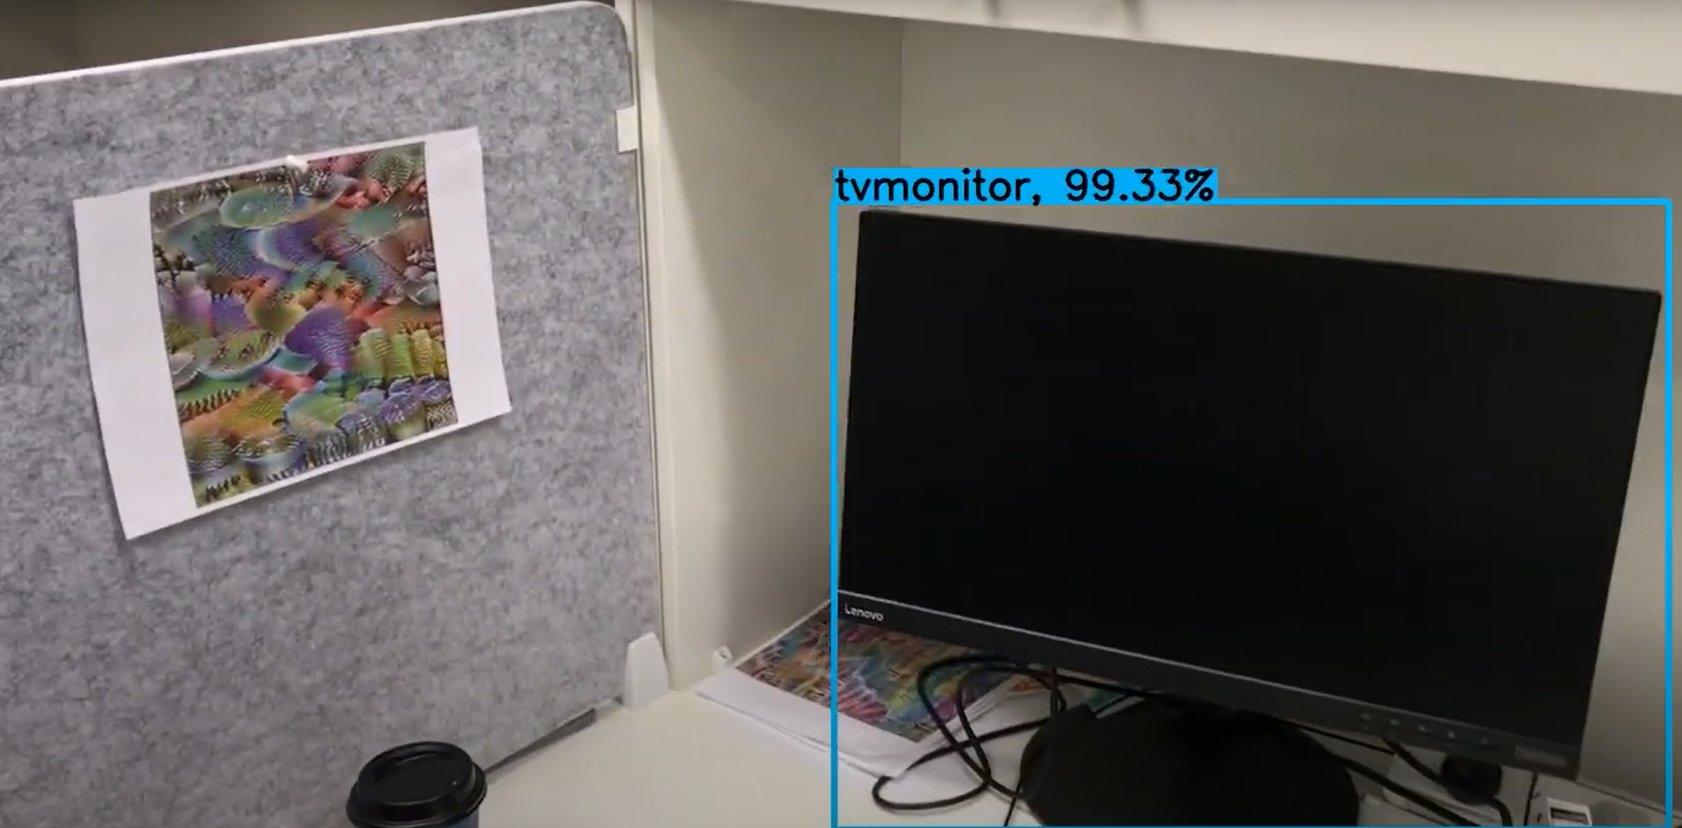


Front View
Another Perspective

